Slide 1
Vehicle Movement Analysis and Insight Generation in a College Campus using Edge AI

Slide 2
Unique idea (Solution)
Vehicle Movement Analysis and Insight Generation in a College Campus using Edge AI involves deploying AI-powered cameras and edge devices across the campus to monitor and analyze vehicle movements in real-time. The process starts with capturing video footage at strategic locations using edge AI cameras, which locally process the data to detect and track vehicles, reducing latency and bandwidth usage. The edge devices use advanced algorithms to extract features such as vehicle type, speed, and direction, and send summarized data to a central server. This data is then preprocessed and integrated into a comprehensive database for further analysis. Machine learning models are applied to identify patterns, anomalies, and peak usage times. Insights are generated on traffic flow, parking occupancy, and potential bottlenecks, which are visualized through dashboards for real-time monitoring and decision-making by campus administrators. This system enhances traffic management, optimizes parking utilization, and improves overall campus safety and efficiency.

Slide 3
Features offered
Data Pre-processing: Effective cleaning and pre-processing of the dataset, handling missing values, normalization, and feature engineering.
Vehicle Movement Analysis: accurate analysis of vehicle movement patterns, identifying peak times and patterns.
Parking Occupancy Monitoring: Effective monitoring of parking lot occupancy in real-time.
Vehicle Matching: Accurate matching of vehicles to the approved vehicle database and identification of unauthorized vehicles.
Insight Generation: Generation of clear and meaningful insights from the data analysis, presented in an understandable manner.

Slide 4
Process flow
The process begins with data collection from cameras installed at strategic locations around the campus, which is then transmitted to Edge AI-enabled devices for processing. The Edge AI algorithms detect and track vehicles in real-time, generating metadata such as vehicle type, speed, direction, and location. The devices then analyze the video feeds to generate a trajectory of each vehicle's movement, including its route, speed, and time of travel. The data is transmitted to a central server or cloud-based platform for further analysis, where it is processed to generate insights on vehicle movement patterns, such as peak hours of traffic congestion, most frequently used routes, and average speed of vehicles. The insights are then used to identify opportunities for improvement in campus traffic management, and real-time alerts and notifications are generated based on predefined rules and thresholds. Finally, the system continuously monitors and evaluates its effectiveness, making adjustments as needed to improve accuracy and performance, and leveraging Edge AI benefits such as reduced latency, improved accuracy, increased efficiency, and enhanced security.

Slide 5
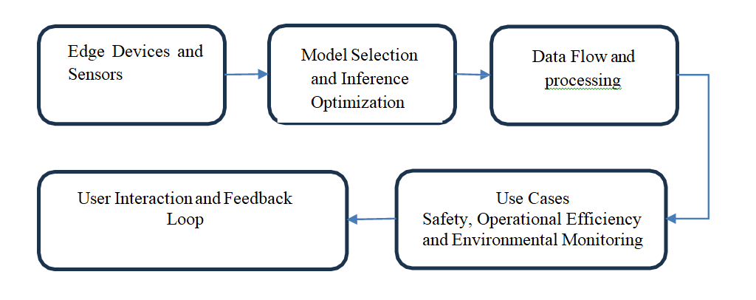
Architecture Diagram:

Slide 6
Technologies used
Tools: OpenCV, Pandas, NumPy.
Techniques: Image resizing, grayscale conversion, handling missing values.

Slide 7
Team members and contribution:
Ankita: Data Detection
Deeksha: Preprocessing
Ranjitha: Synopsis

Slide 8
Conclusion
This innovative solution leverages advanced computer vision and machine learning techniques to address the challenges of vehicle movement analysis, parking occupancy monitoring, and traffic management. By integrating real-time data analytics and smart decision-making, cities and organizations can achieve efficient and sustainable urban mobility solutions. This approach not only enhances operational efficiency but also contributes to safer and more convenient transportation experiences for users.

